Slide 1
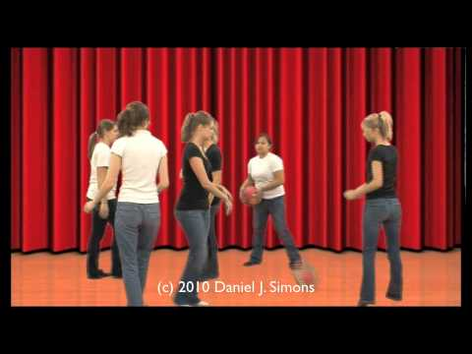

Mindfulness II
Notes:
Make sure they understand the instructions
Pause after 16, ask who got it right
Was there something you did today that no one noticed? (Were you all alone, or around others but no one noticed-- where you glad they didn’t notice, or were you upset?)
Is there someone about yourself that people don’t notice? Did you see something today you’ve never seen before?
When we’re wearing our masks, do you think people can realize what we’re feeling under our masks? How can they tell?
Homework is to pay attention to what’s around you and try to notice something you’ve never noticed before-- try to see if you can tell what someone’s feeling beneath their mask?

Slide 2
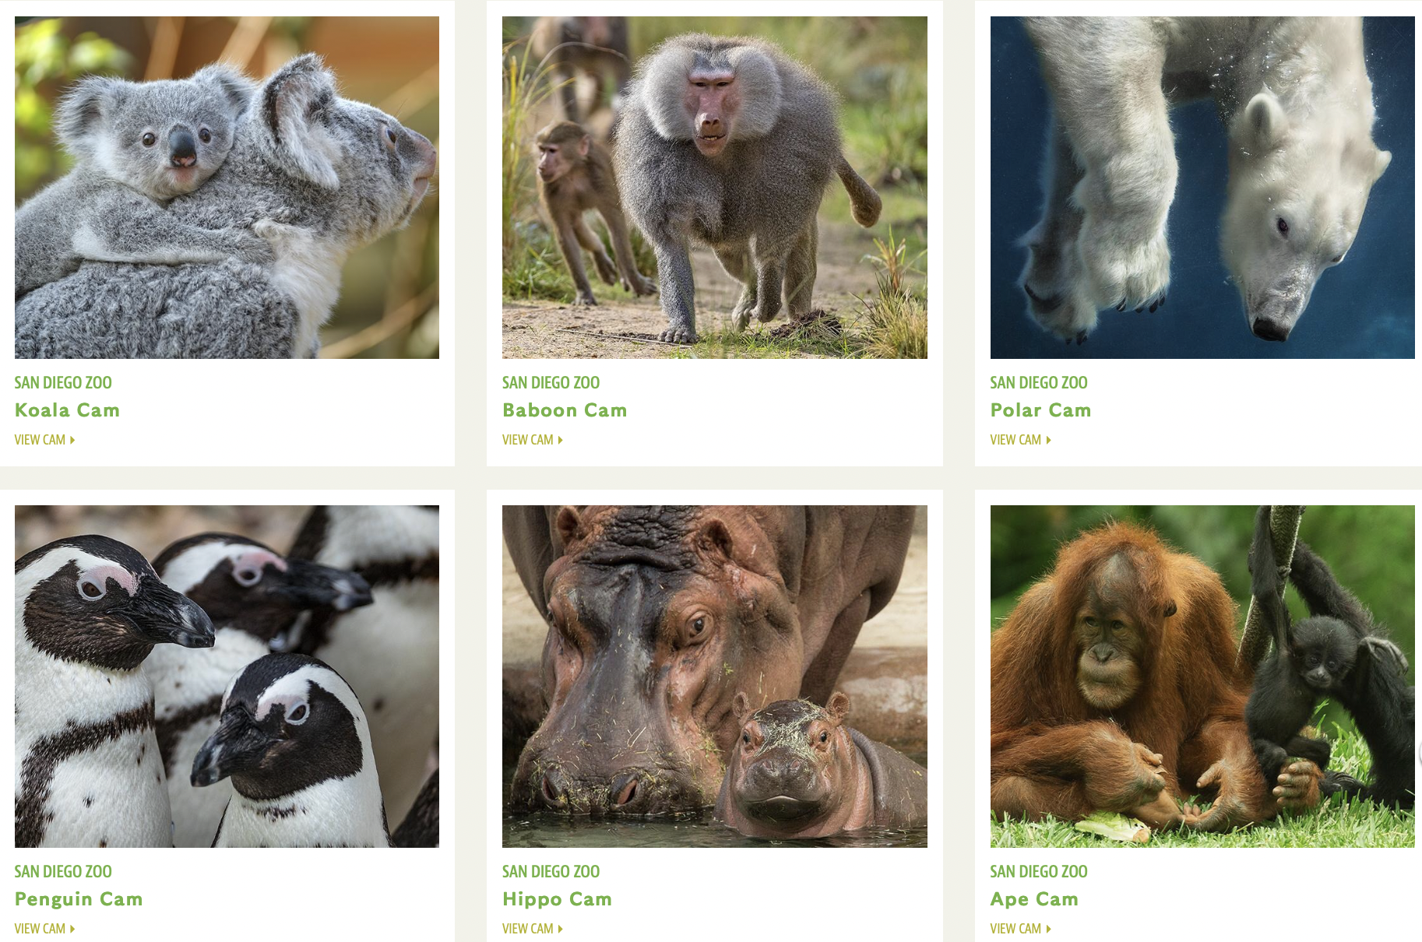
Live Animal Cameras: Watch, What do you See?
https://zoo.sandiegozoo.org/live-cameras

Slide 3
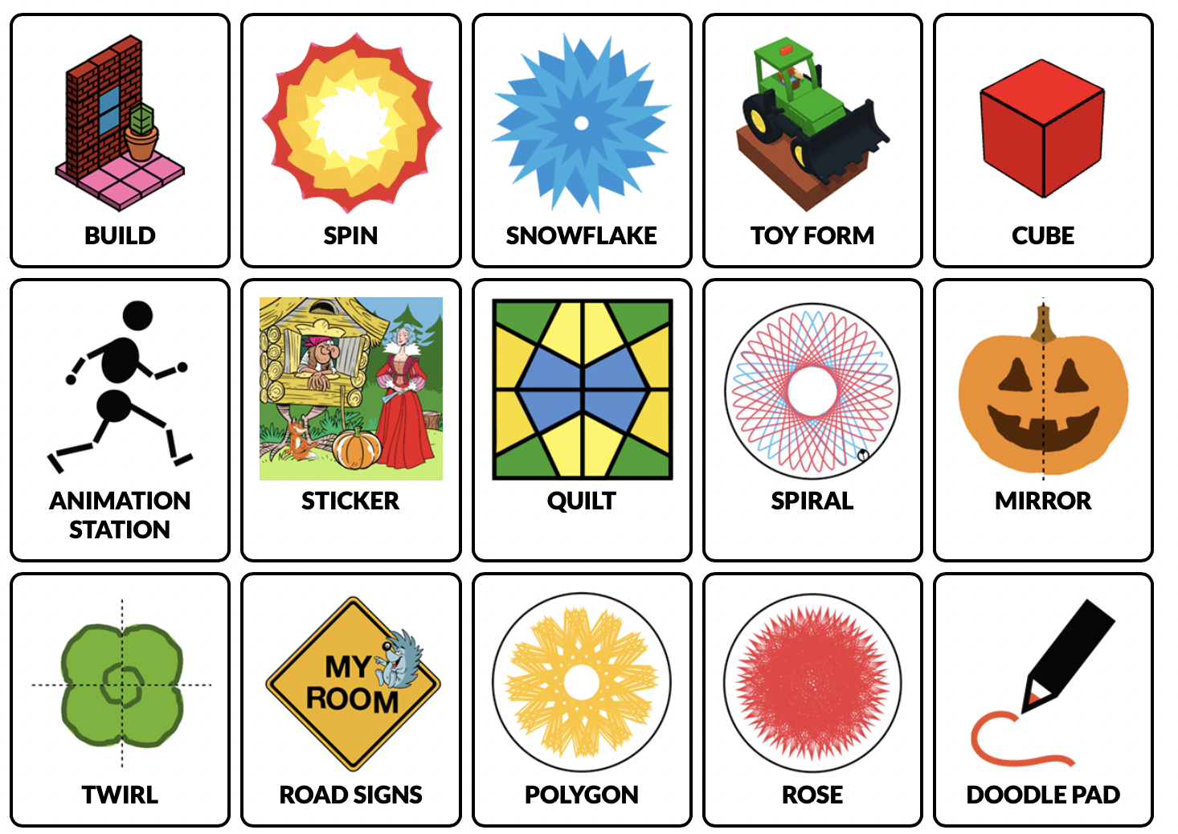
Colors, Shapes, and Patterns: What do you feel?
https://toytheater.com/category/art/

Slide 4
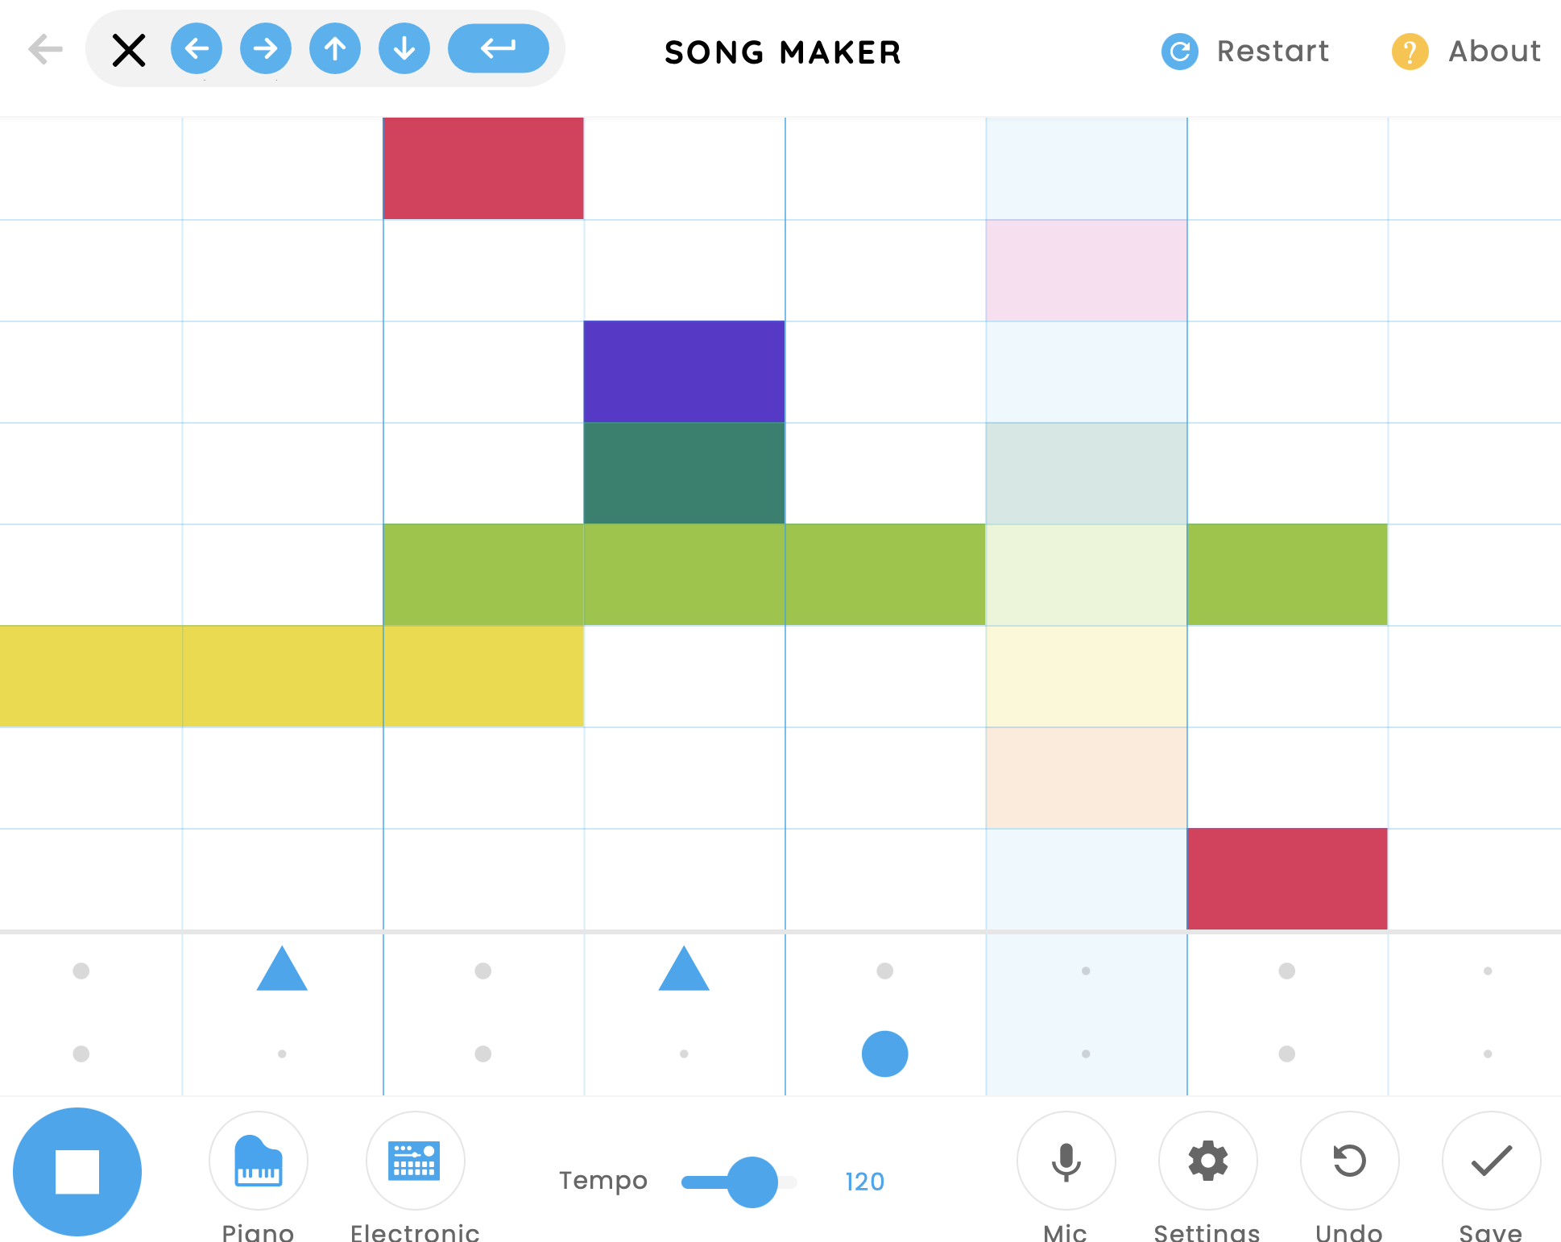
Make Music: What do you Hear?
https://musiclab.chromeexperiments.com/Song-Maker/

