Slide 1
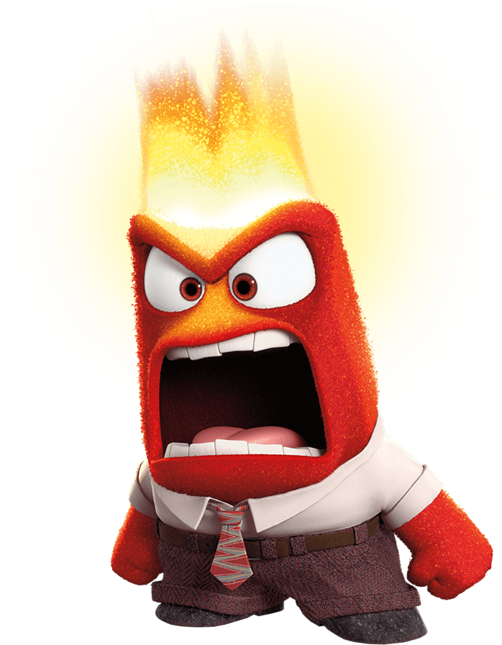
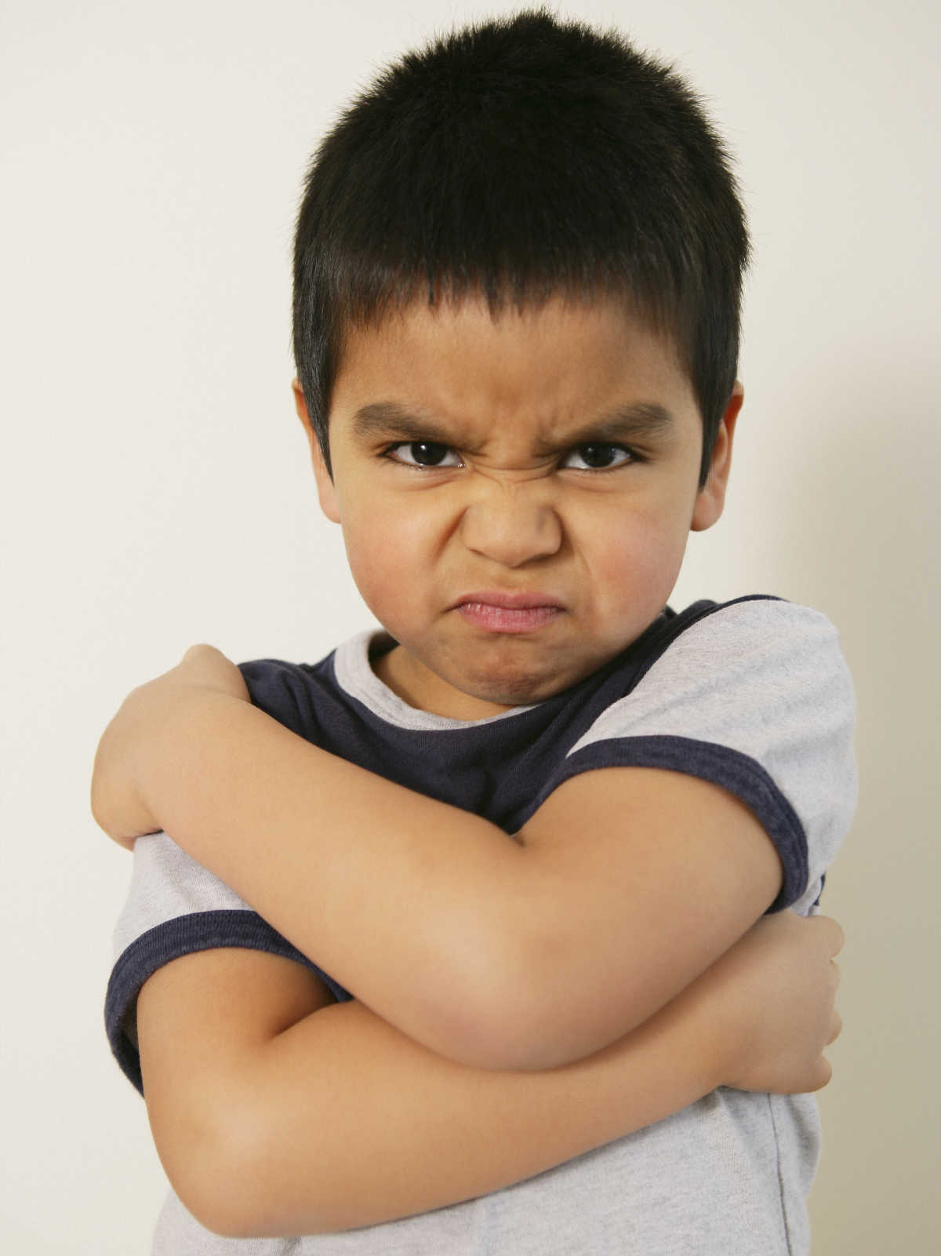
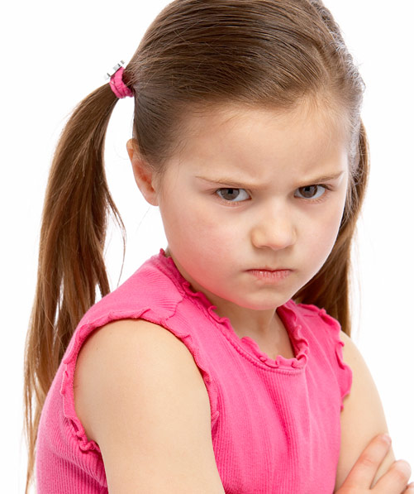

Feeling Angry

Slide 2
WHAT DOES AN ANGRY FACE LOOK LIKE?
DRAW HERE OR ON A PIECE OF PAPER.

Slide 3
WHERE DO YOU FEEL ANGER IN YOUR BODY?
DRAW HERE OR ON A PIECE OF PAPER.

Slide 4
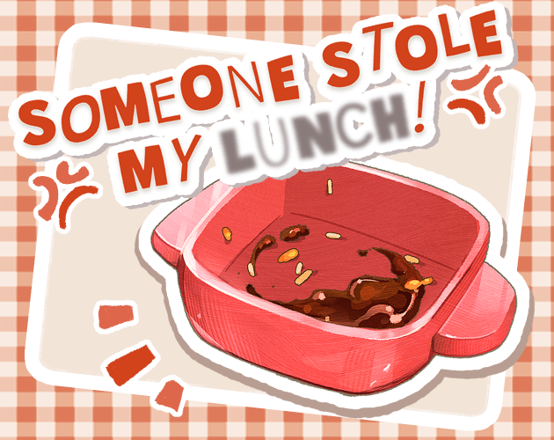
SITUATION: I SPY……SOMeONE STOLE MY LUNCH!

Slide 5
SITUATION
SOMEONE STOLE MY LUNCH!
?

Slide 6
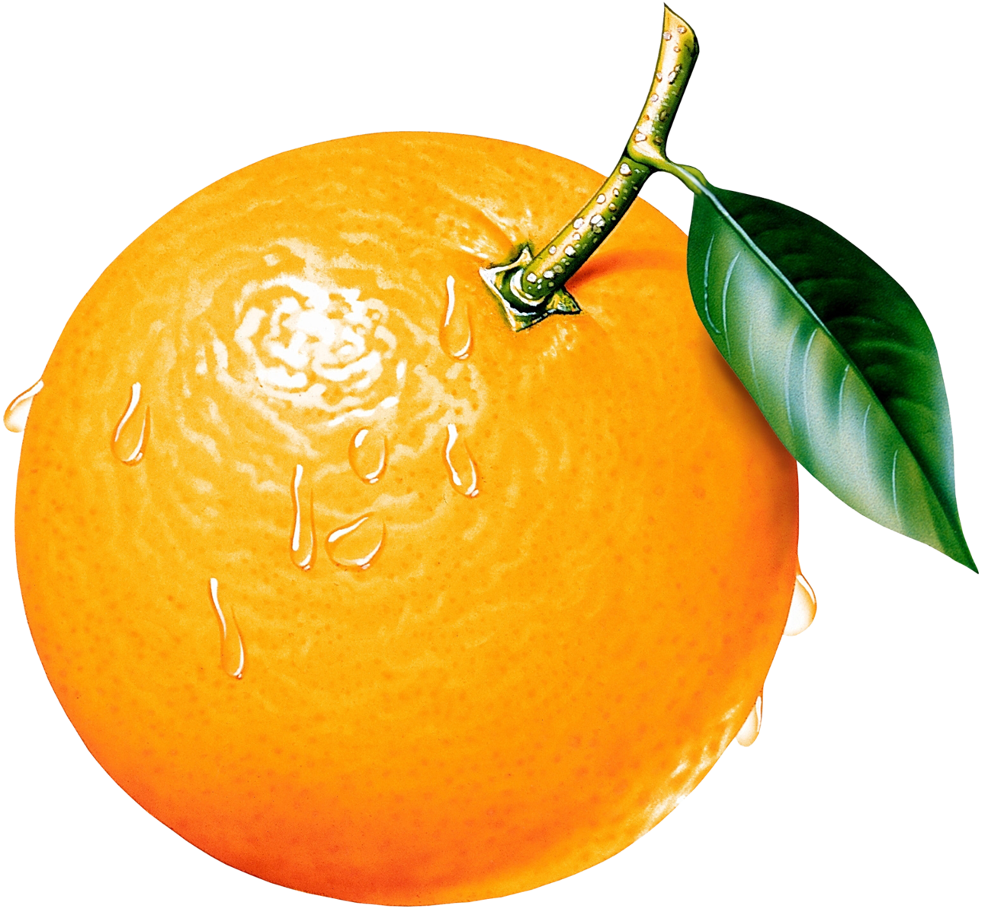
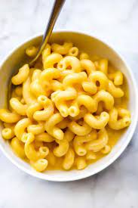
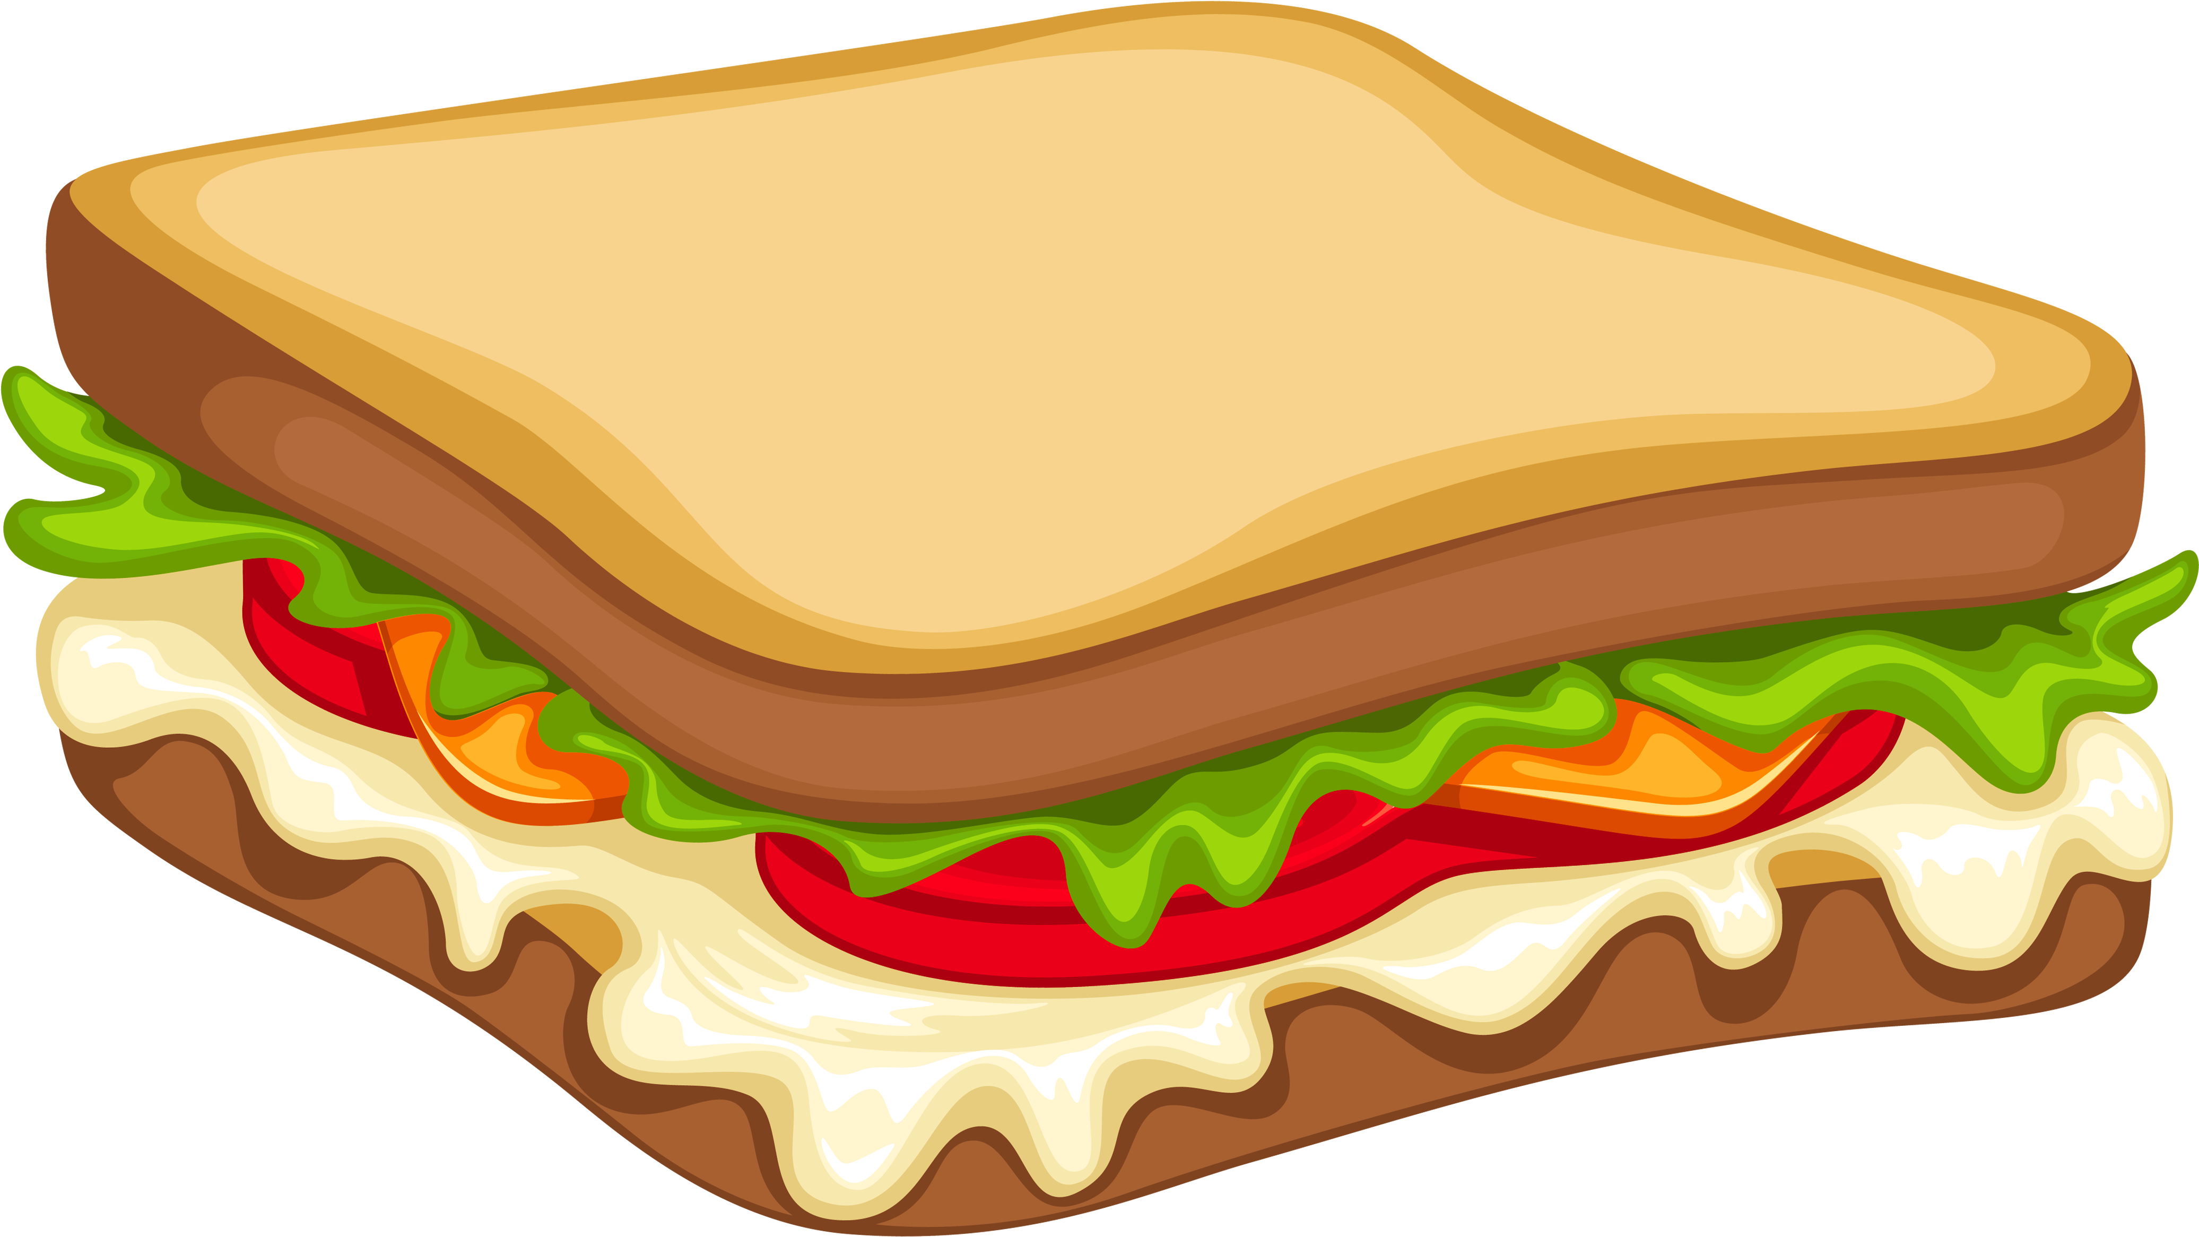

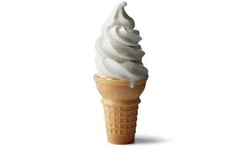
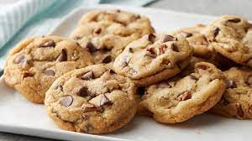
SITUATION
SOMEONE STOLE MY:

Slide 7
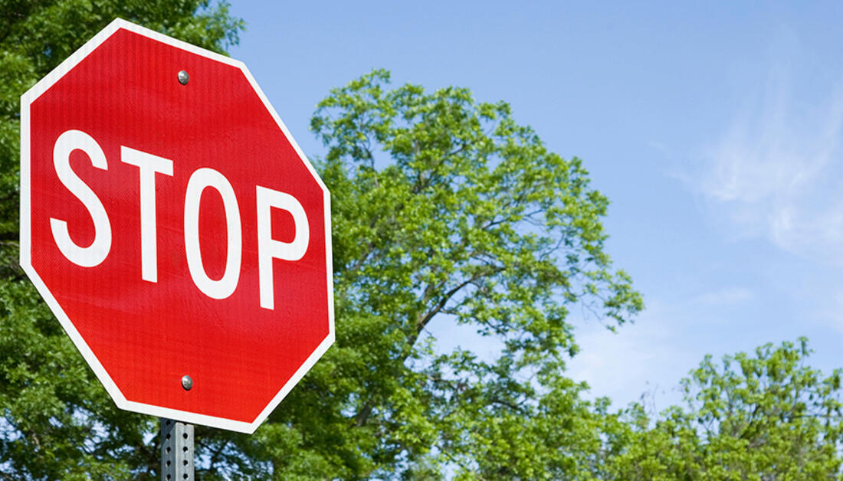
BEFORE YOU ACT…
STOP

Slide 8

BEFORE YOU ACT…
STOP
BREATHE

Slide 9
BEFORE YOU ACT
STOP
BREATHE
NAME THE FEELING: I FEEL ANGRY. YOU ATE MY FOOD AND I’M HUNGRY.

Slide 10
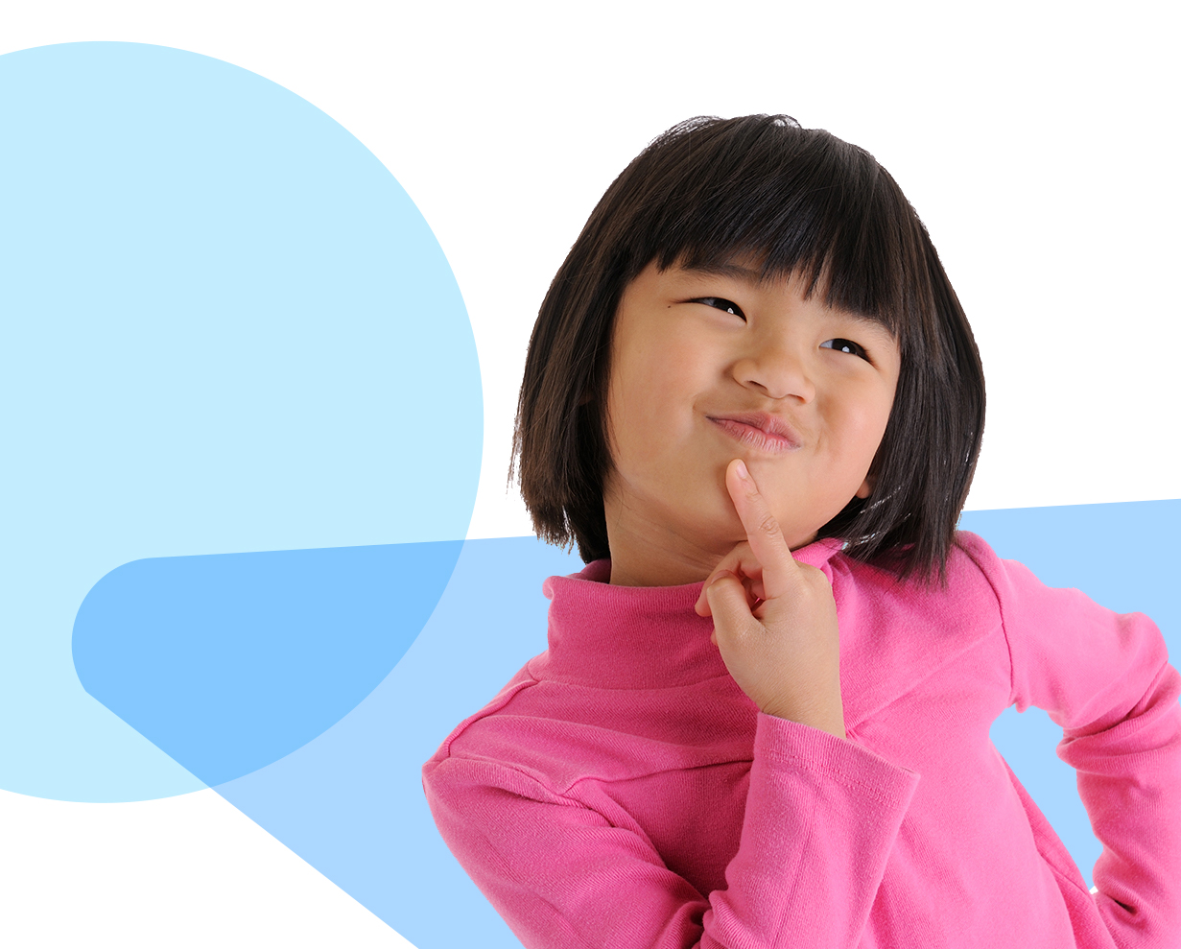
BEFORE YOU ACT…
STOP
BREATHE
NAME THE FEELING
THINK: GOOD OR BAD CHOICES

Slide 11
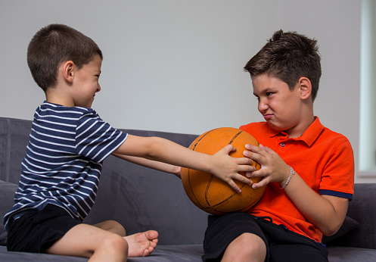
SITUATION: My sibling stole my favorite toy

Slide 12
SITUATION:
SOMEONE STOLE MY TOY!
?

Slide 13
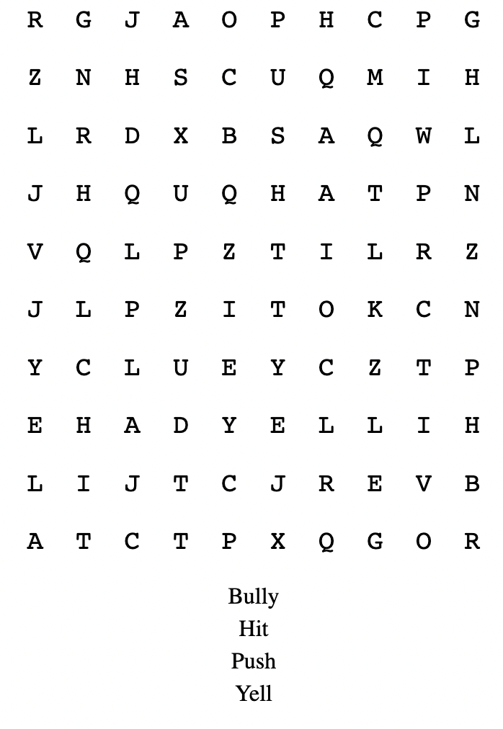


BAD CHOICES

Slide 14
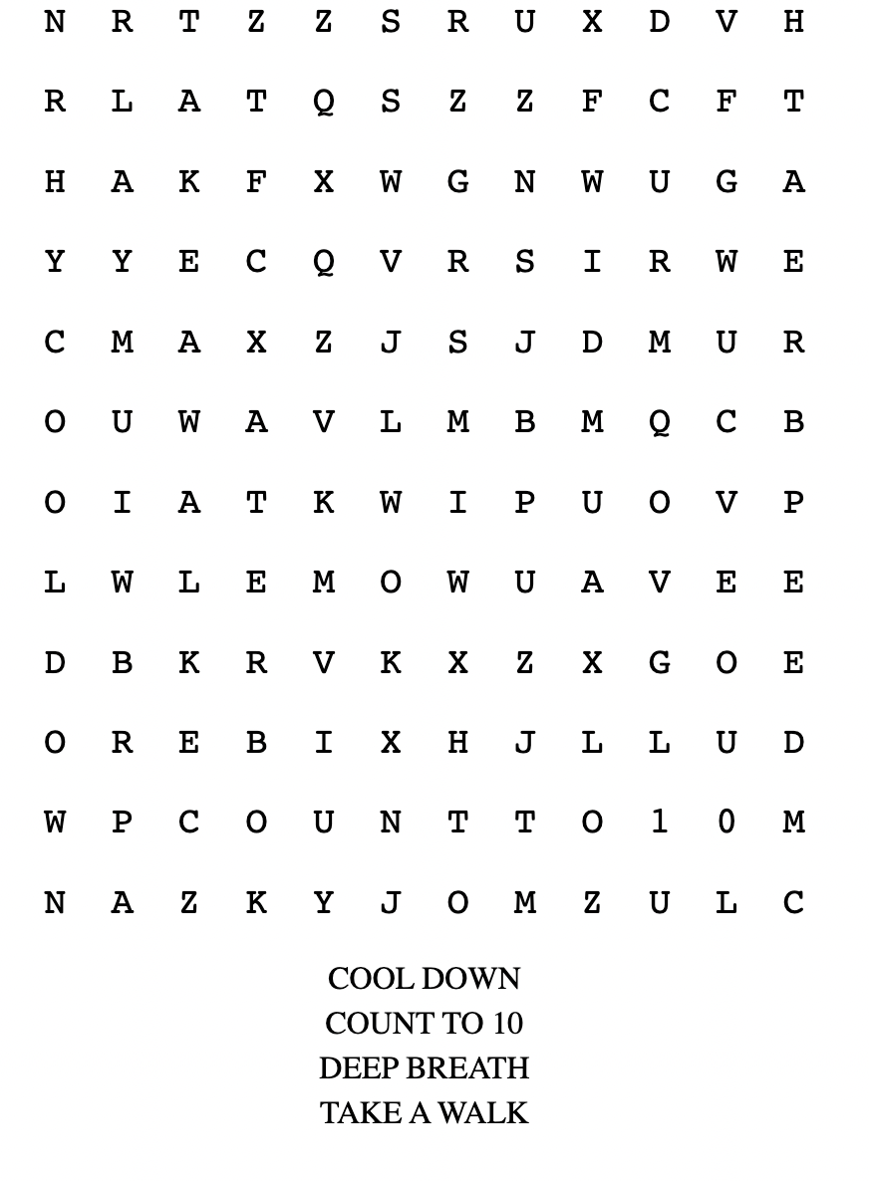


GOOD CHOICES

Slide 15

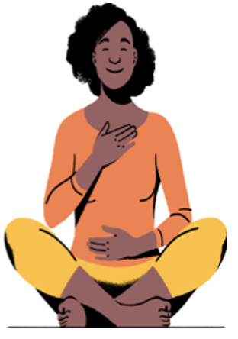

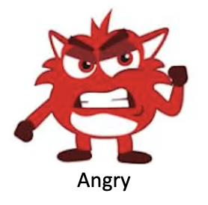

Let’s End with Butterfly Breathing

