Slide 1

MINDFULNESS I:
I spy
Guess the insect or animal
Notes:
Before we play Ispy, who worked on their butterfly breathing? - when, how, how they felt?

Slide 2
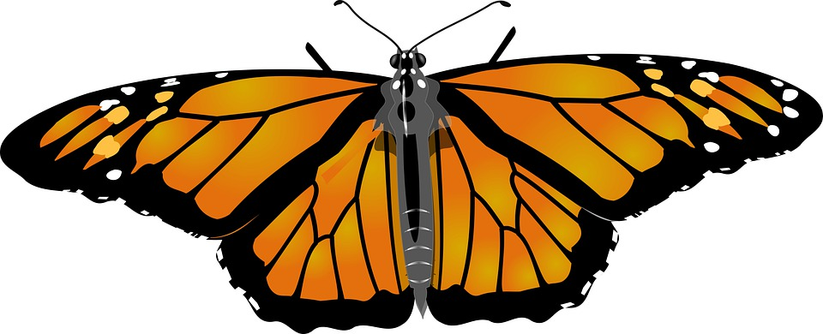

Slide 3
Butterfly

Slide 4
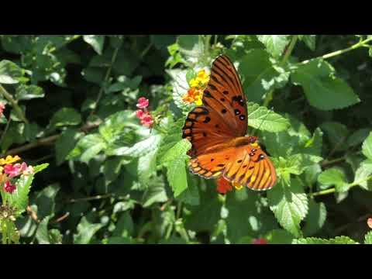
Butterfly video
Notes:
Count how many different color flowers they see

Slide 5
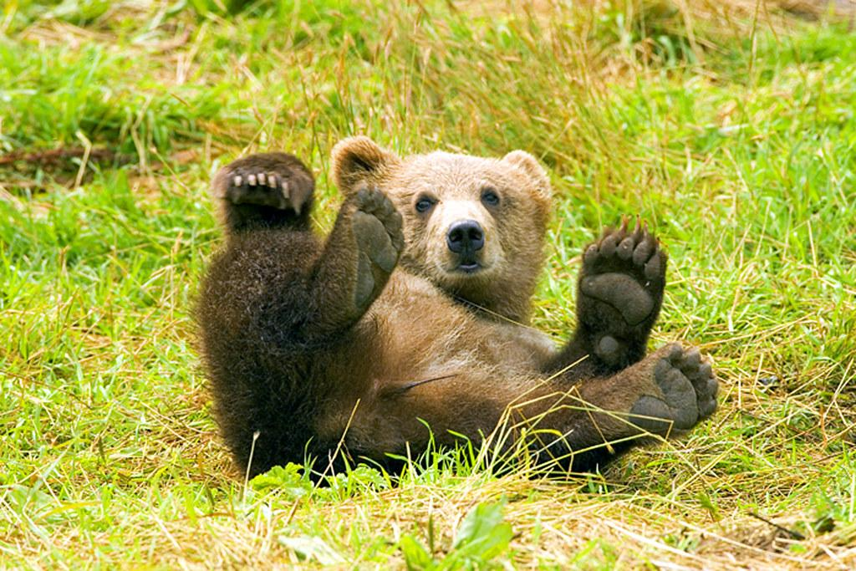

Slide 6
Bear

Slide 7
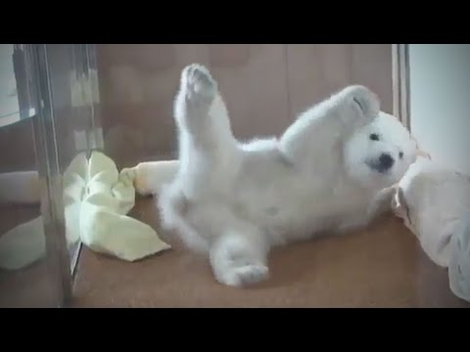
Meet some bears playing
Notes:
When it moves on to the polar bears- ask them what color was the hose?
Move screen- how many birds were in the background?

Slide 8
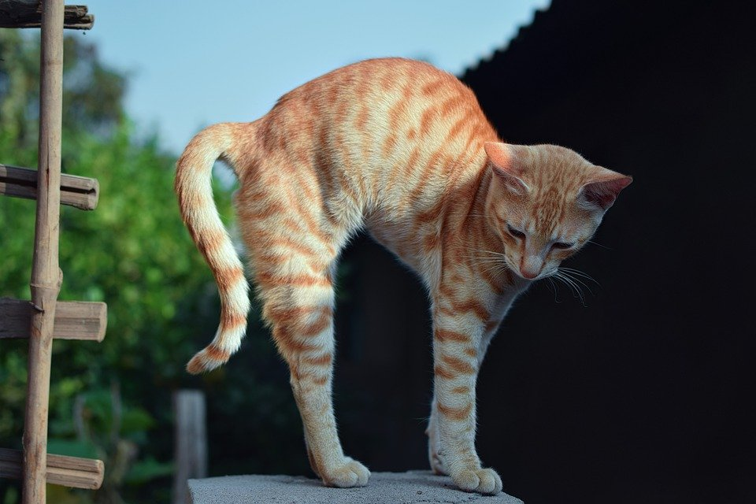

Slide 10
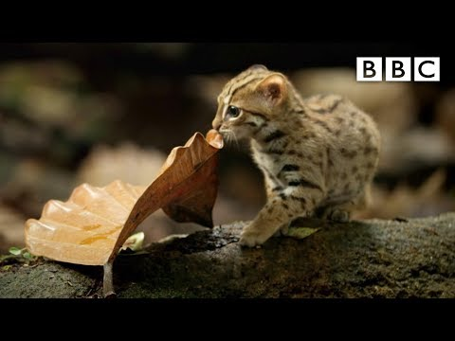
World’s smallest cat
Notes:
“You’ve seen this before, now pay attention…” What was he afraid to touch?

Slide 11
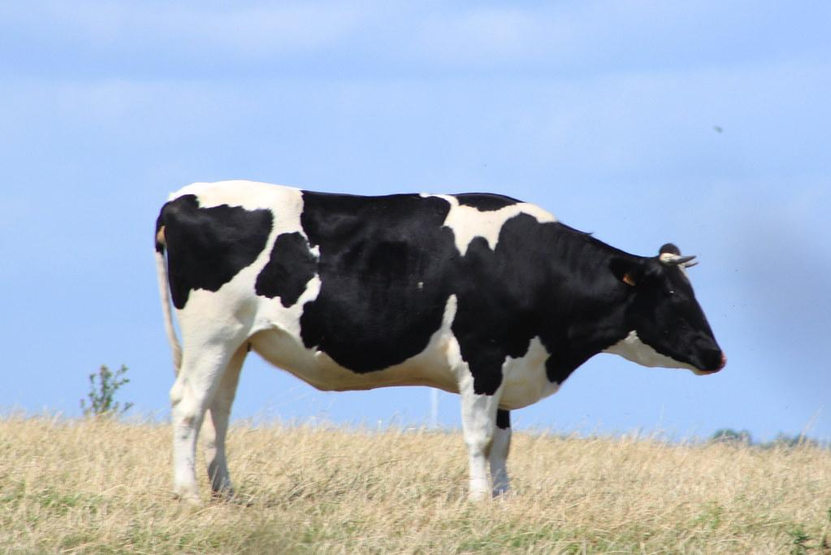

Slide 12
Cow

Slide 13
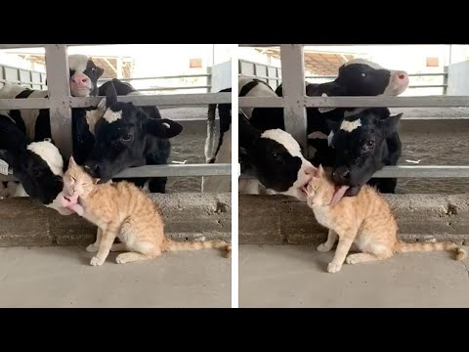
Cat and cows playing
Notes:
As you watch, count how many cows are in the pen?

Slide 14
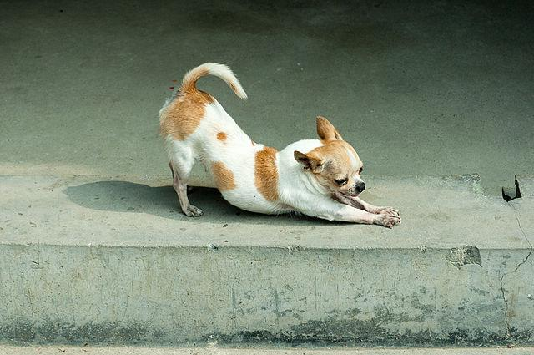

Slide 15
Dog (downward pose)

Slide 16

Dog Fun Facts
Notes:
How many dogs do you remember were sitting in front of the pink wall?
Bonus- color of bow in the beginning?

Slide 17
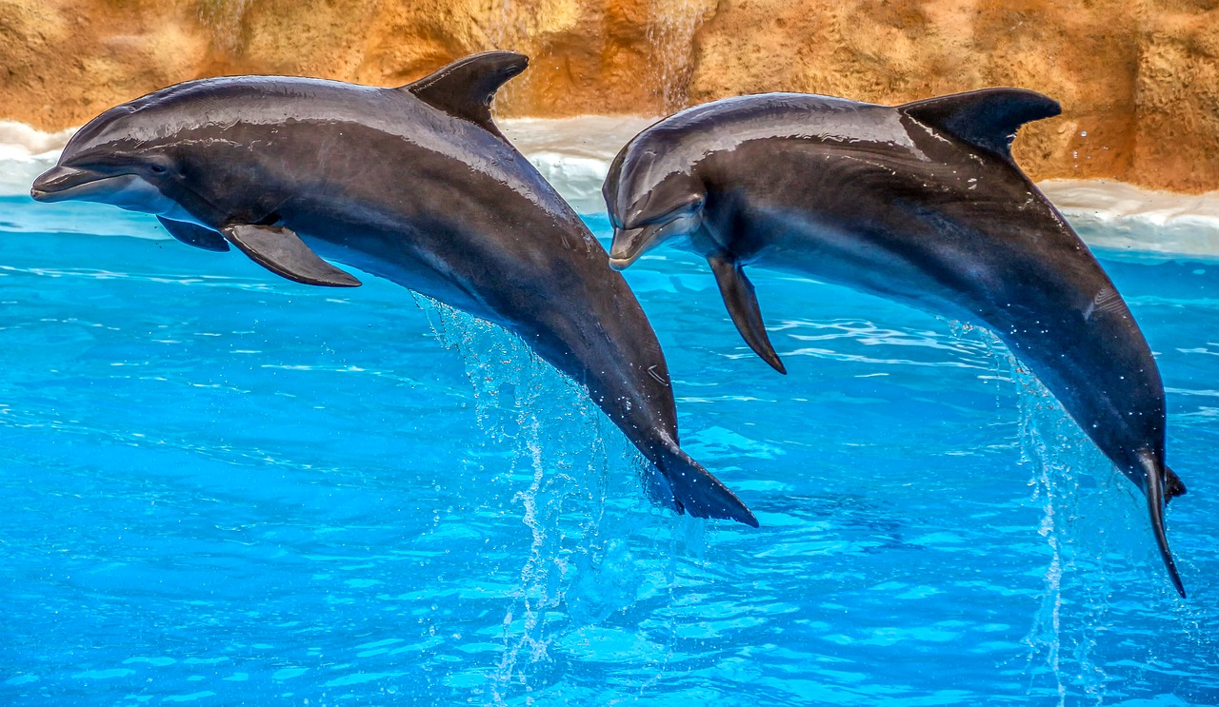

Slide 18
dolphin

Slide 19
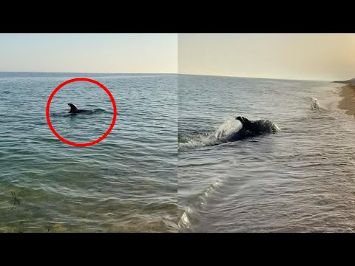
Dolphins Play with dog
Notes:
Describe the dogs tail

Slide 20
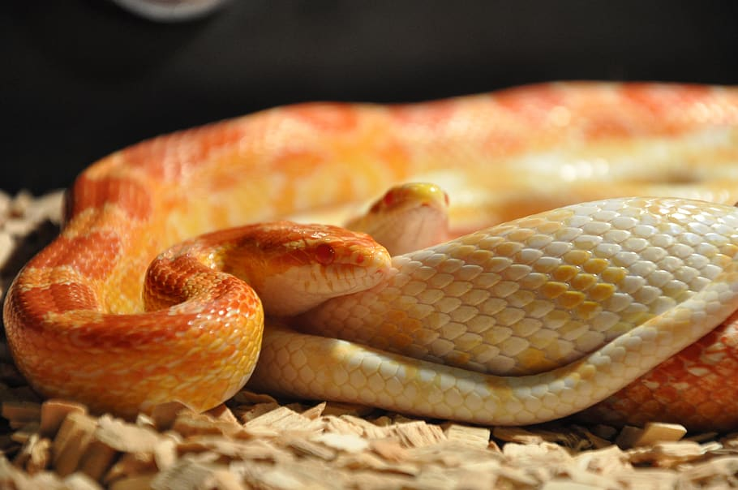

Slide 21
snake

