Slide 1
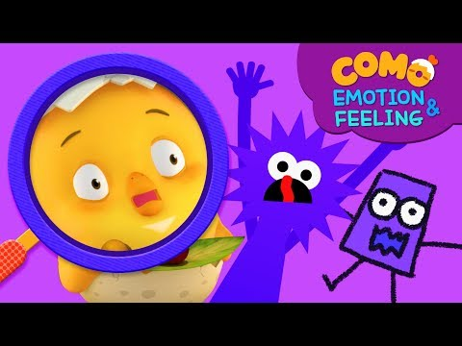
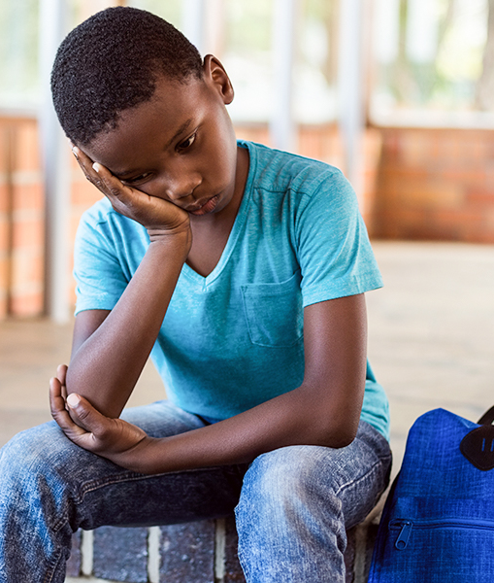
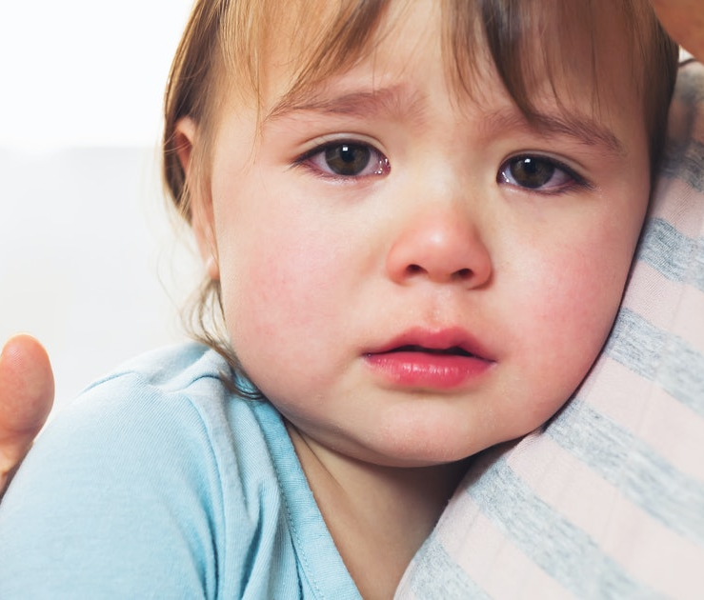

Feeling Sad or Anxious

Slide 2
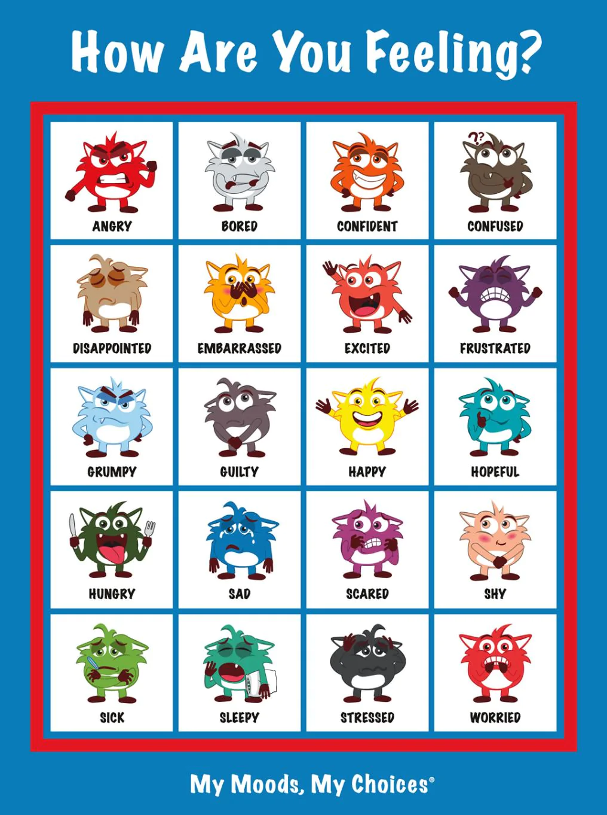
I SPY….
What emotions did you spy in: you today?
your friend?
your family?

Slide 3
I SPY…..WHAT ARE THINGS YOU CAN DO TO FEEL BETTER?
UNSCRAMBLE THE WORDS:
GUH
REINDF
ECTAHRE
OKOB
VNOT
ONDEMAI
REABTHE
AYOG
LAYP
WORD BANK:FRIEND TEACHER HUG BOOK NO-TV BREATHE NO-MEDIA YOGA PLAY

Slide 4
S | O | R | R | Y | 😔 | N | F
B | 😩 | R | Q | G | M | O | R
U | N | 😟 | H | U | G | T | I
T | 😓 | O | B | C | D | V | E
T | E | A | C | H | E | R | N
E | K | 😘 | 😳 | V | N | M | D
R | 😊 | S | W | B | O | O | K
F | C | P | N | W | M | Q | Z
L | Y | 😒 | D | P | L | A | Y
Y | O | G | A | L | K | J | J
WHEN I FEEL SAD 😓 OR SCARED 😩🥺 I CAN:
SORRY
BUTTERFLY
PLAY
HUG
YOGA
BOOK
FRIEND
TEACHER
NO TV
Notes:
d

Slide 5
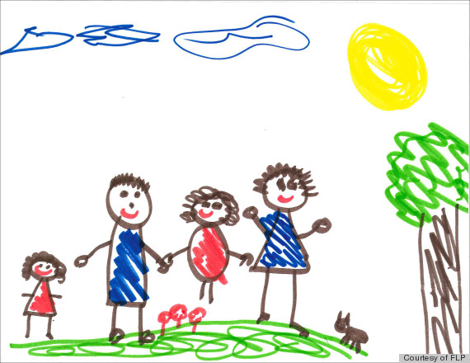
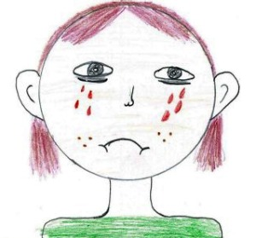
When You are Sad, draw how you feel, then draw something that will make you feel better

Slide 6
Draw!

