Slide 1

EMPOWER UKRAINE
EMOTIONS PROGRAM
WELLNESS EDUCATION
RESILIENCE

Slide 2
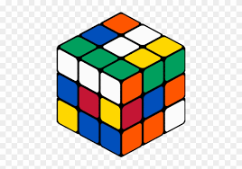
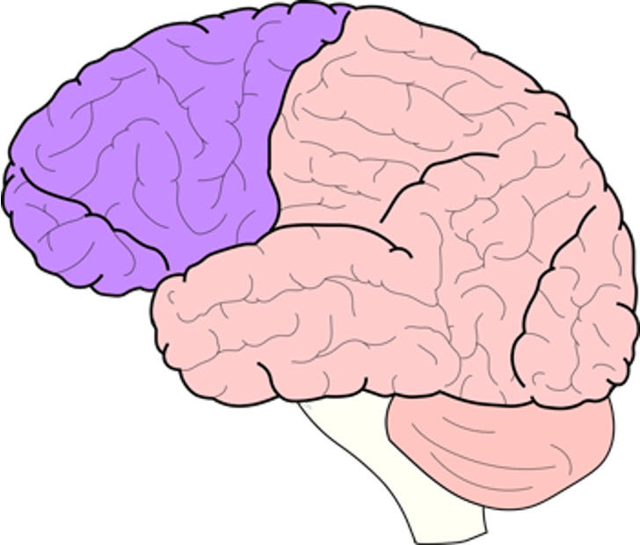
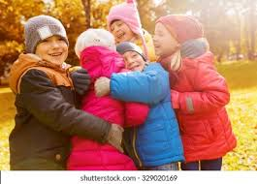
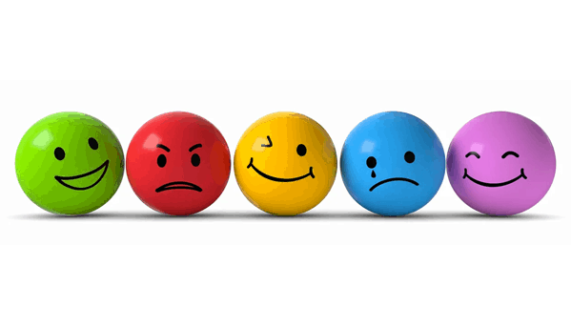

Trauma and Neurodevelopment Interruptions
Cognitive
Attention
Problem Solving
Social Connections
Attachments
Emotional
Expanding Expressions
Regulation
Movement
Fine & Gross Motor
Balance & Coordination
Neural network interruptions as brain develops from back to the front

Slide 3

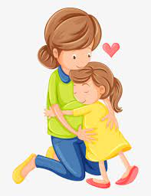

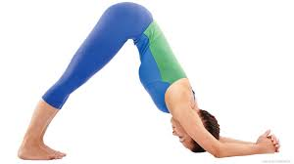
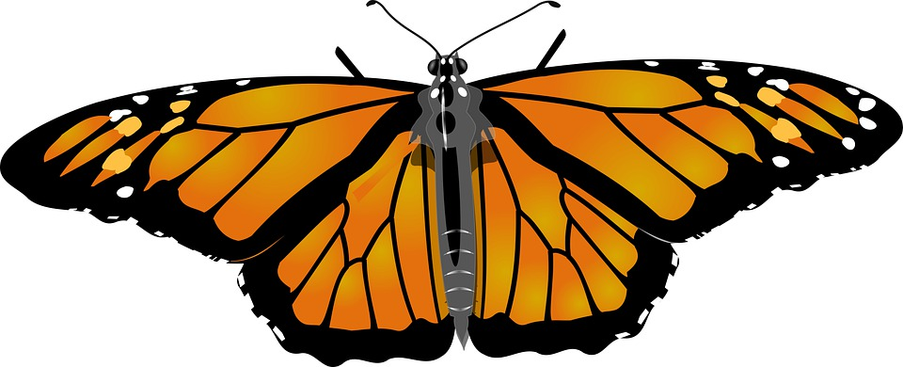
Daily Hi 5 to Build Brain Health
Touch x5
Praise/affirmation/gratitude to self and others x5
You are LOVED
You MATTER
You BELONG
I am GRATEFUL for…….
Movement x5
Deep Breathing x5
Emotional Expression: I feel….. x5

Slide 4
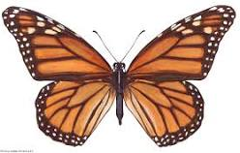
Creating habits
Make it automatic by over-practicing
Habituate by practicing in different settings

Slide 5
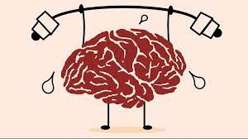
TRAIN YOUR BRAIN:
NEUROPLASTICITY
Neuroplasticity

Slide 6
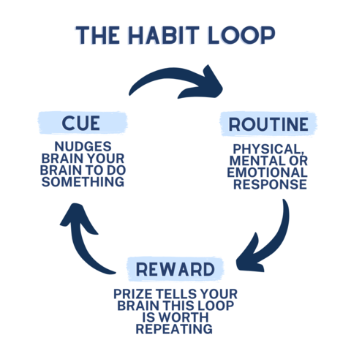
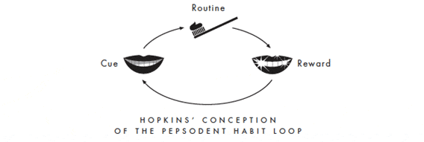
Making It AUTOMATIC
Over-Practicing until it becomes automatic
Strengthen the loop of neural connections:

Slide 7
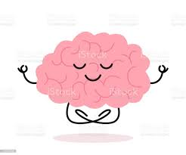

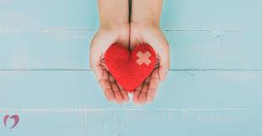
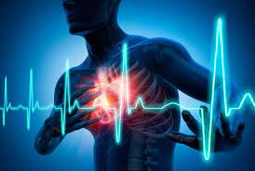
ROUTINE:
CUE:
EMOTION
REWARD:
CUE:
PHYSICAL FEELING

Slide 8
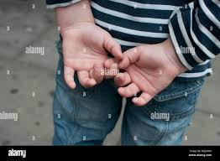

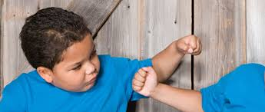
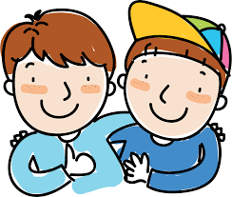
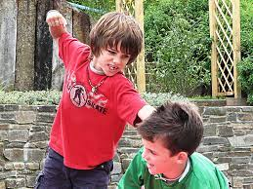
REWIRE BEHAVIOR WITH NEW BEHAVIOR
ROUTINE:Counter-Movement
CUE:MOTOR MOVEMENT=HIT
REWARD:

Slide 9
Counter movement dancing to create motor habit loop!
https://www.youtube.com/watch?v=G6xA8wbSCNM
Watch on

Slide 10
BUTTERFLY Breathing

Slide 11
Activating the brain: I SPY..

Slide 12
Butterfly

Slide 13
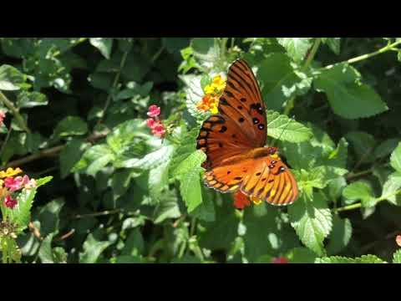
Butterfly video
Notes:
Count how many different color flowers they see

Slide 14
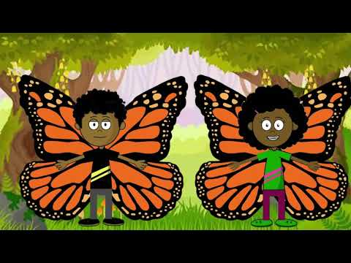
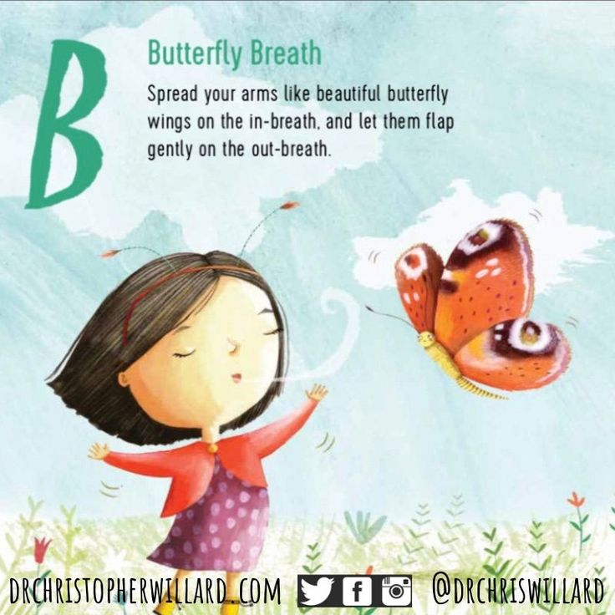
Notes:
Who can demonstrate the butterfly breathing? - feet? Antenna?

