Slide 1
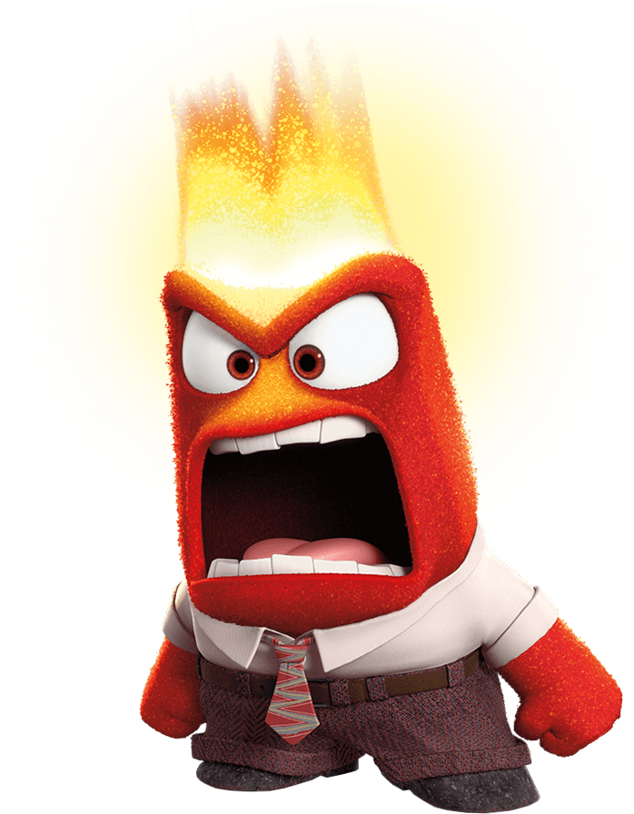
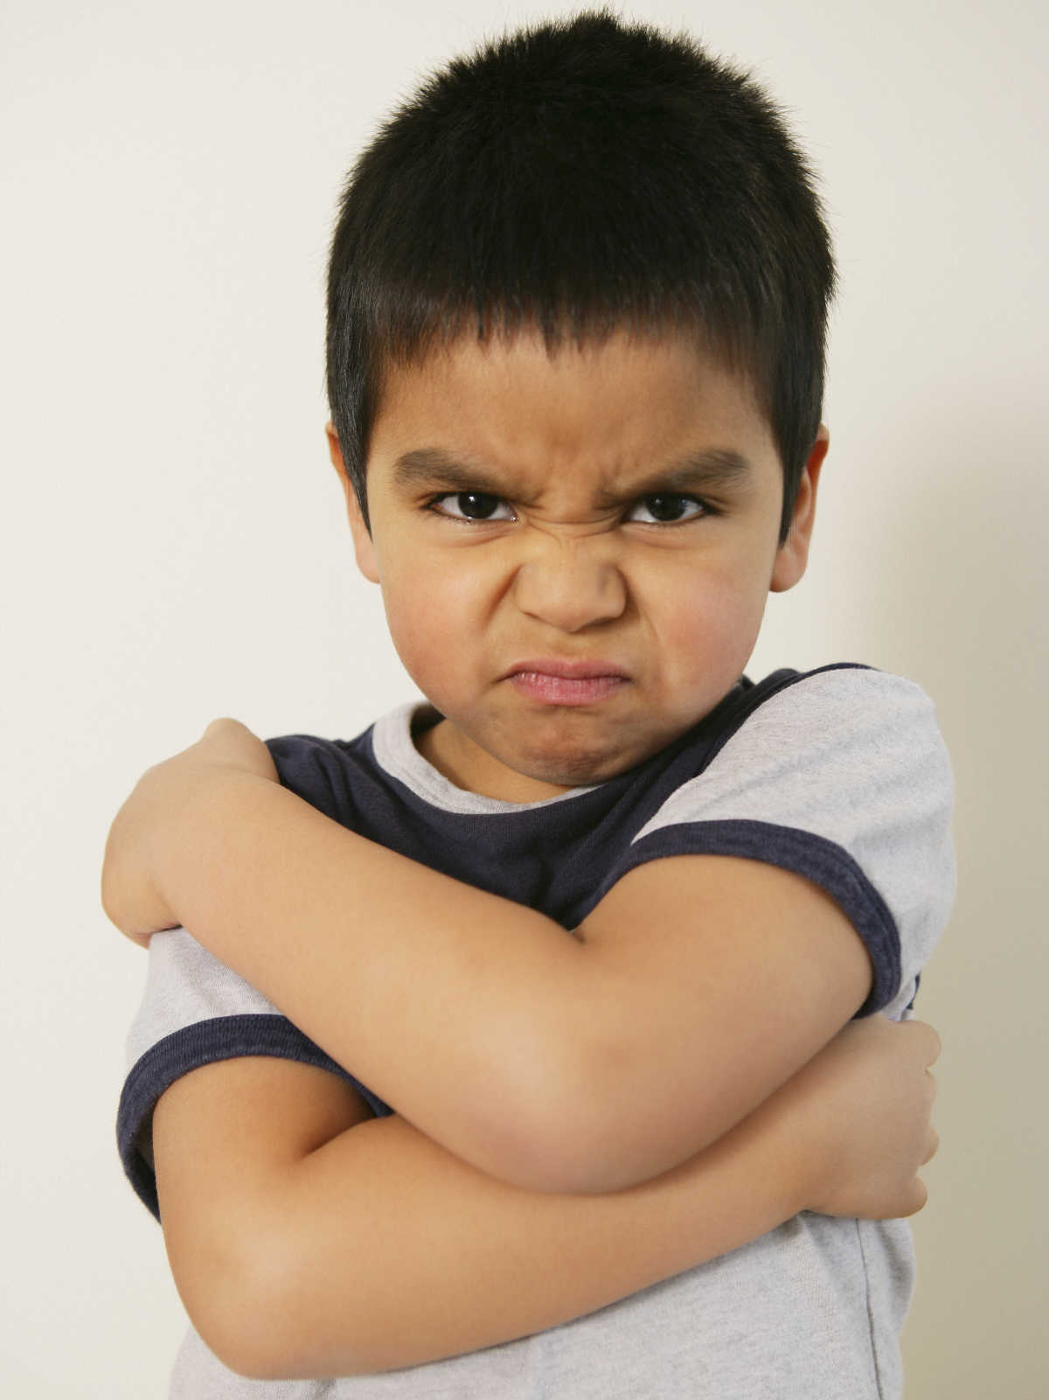
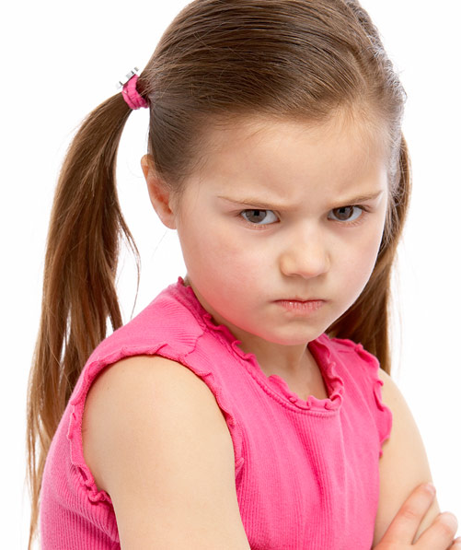

Feeling Angry

Slide 2
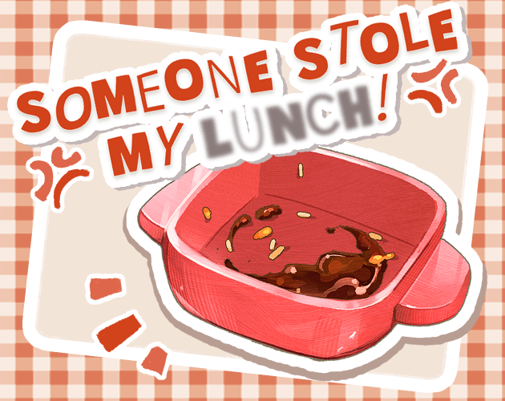
SITUATION: I SPY……SOMeONE STOLE MY LUNCH!

Slide 3
SITUATION
SOMEONE STOLE MY LUNCH!
?

Slide 4
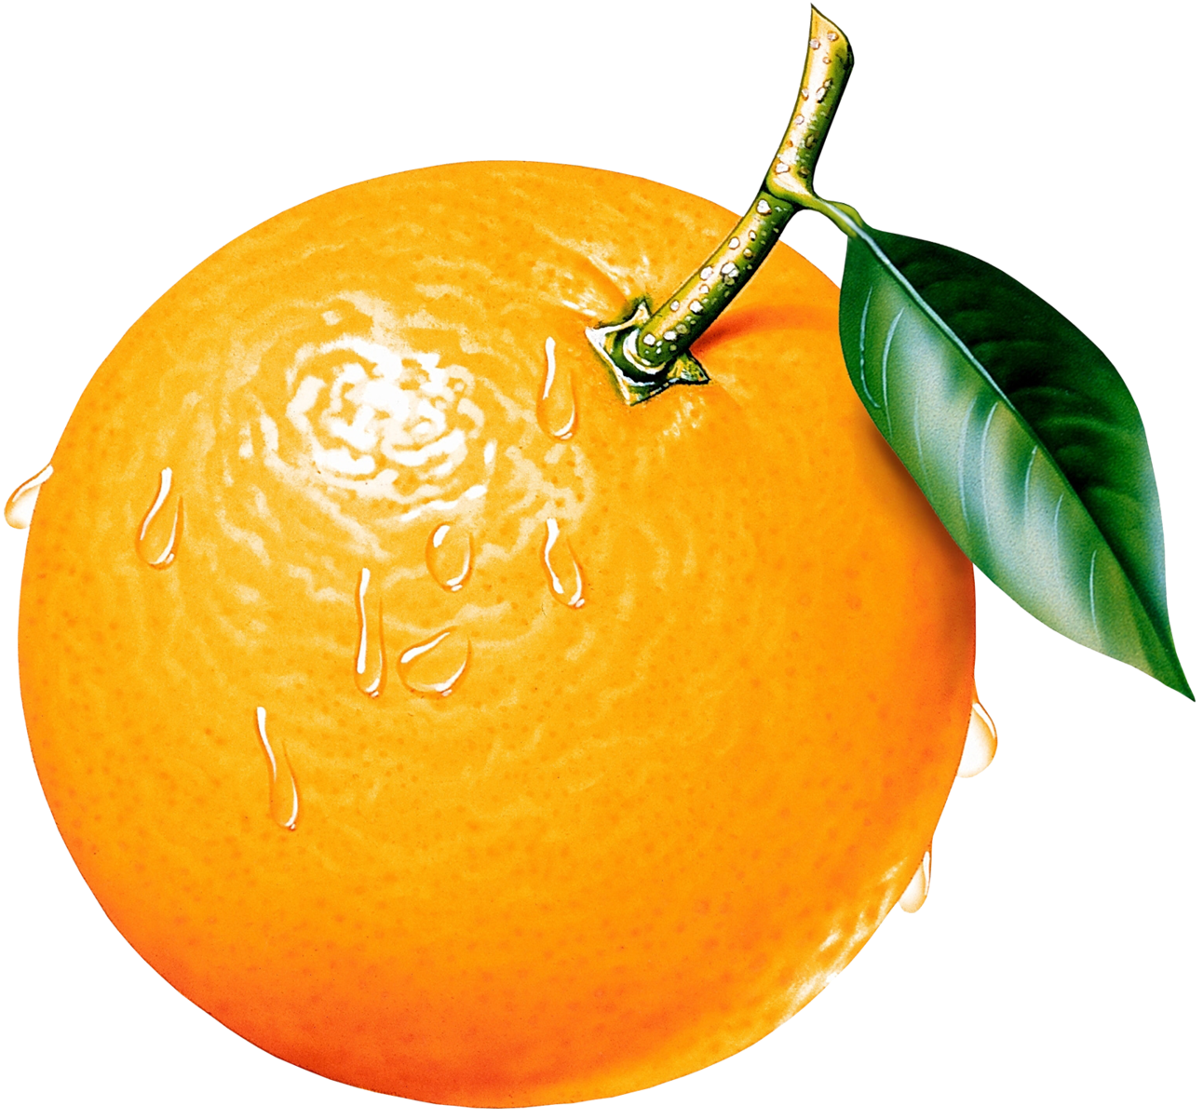
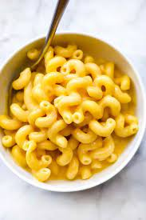
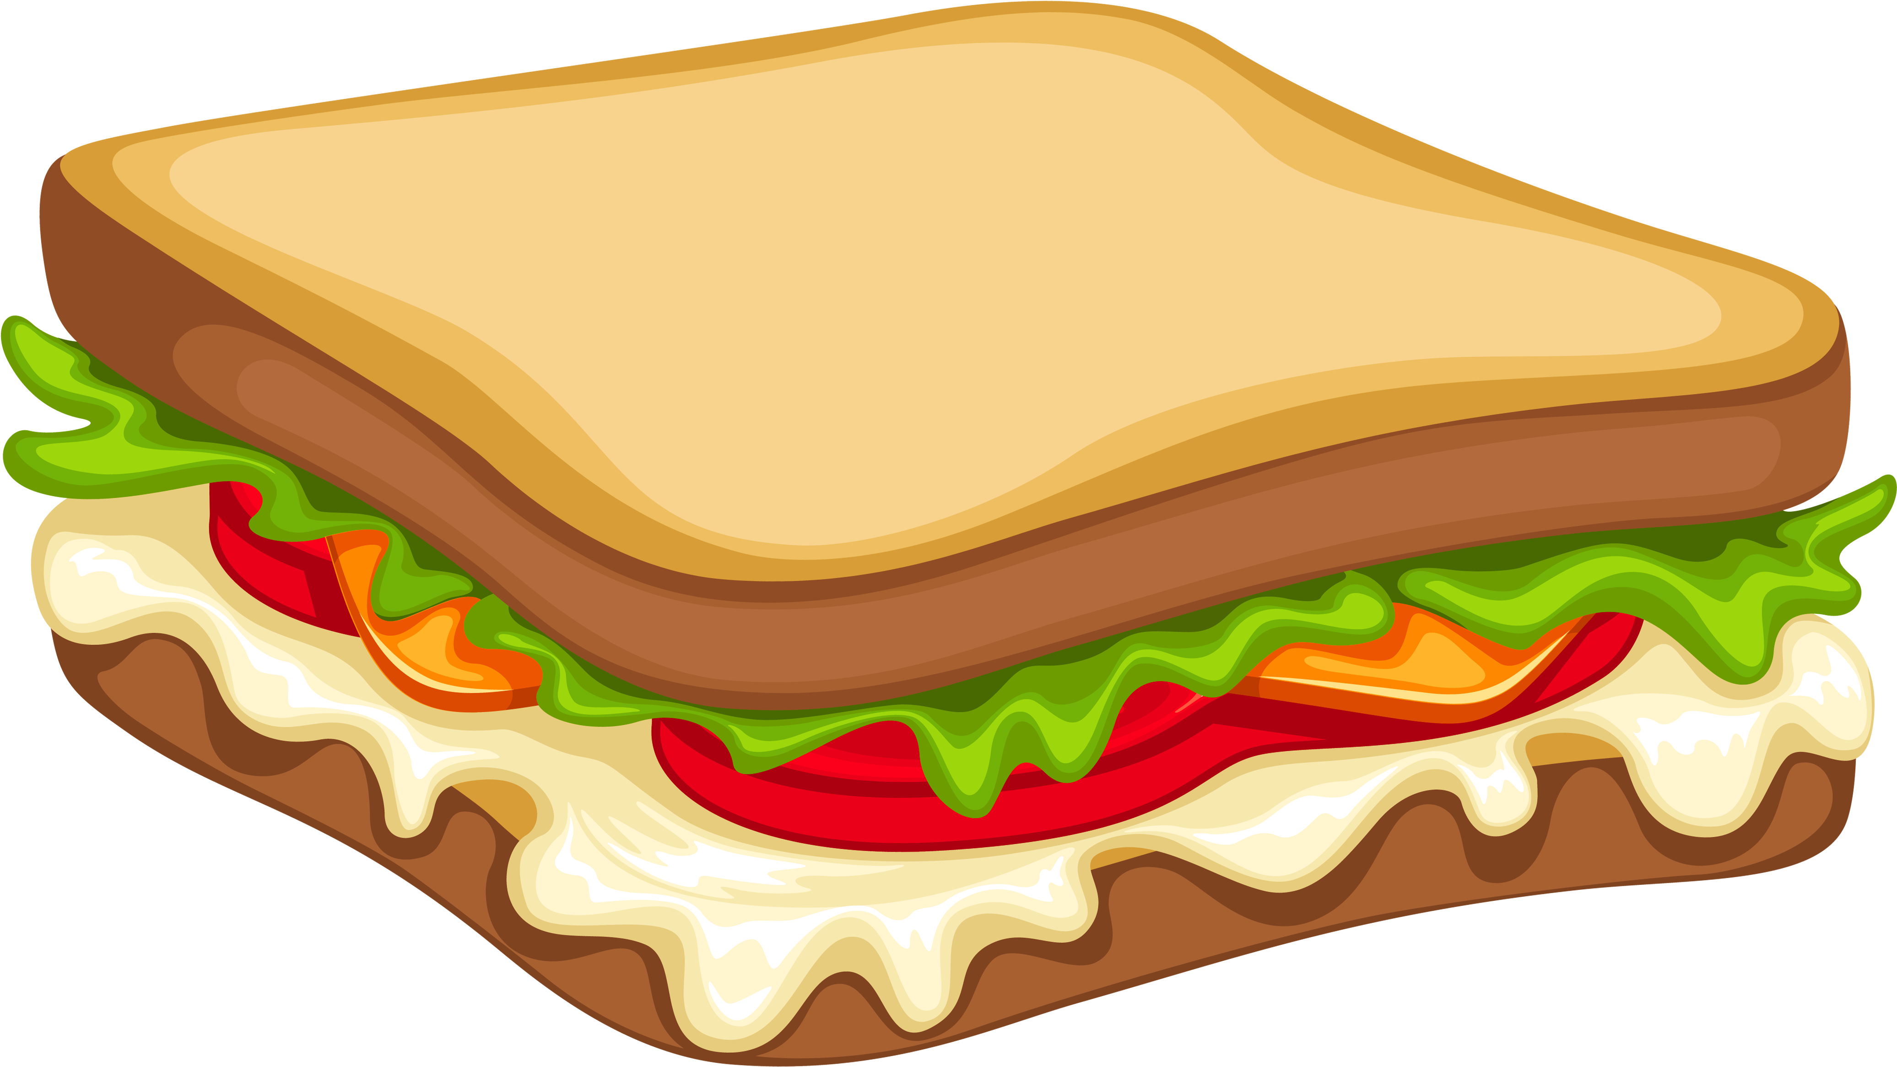

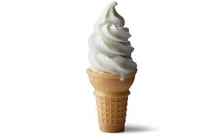
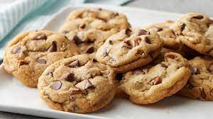
SITUATION
SOMEONE STOLE MY:

Slide 5

BEFORE YOU ACT…
STOP

Slide 6

BEFORE YOU ACT…
STOP
BREATHE

Slide 7
BEFORE YOU ACT
STOP
BREATHE
NAME THE FEELING: I FEEL ANGRY. YOU ATE MY FOOD AND I’M HUNGRY.

Slide 8

BEFORE YOU ACT…
STOP
BREATHE
NAME THE FEELING
THINK: GOOD OR BAD CHOICES

Slide 9
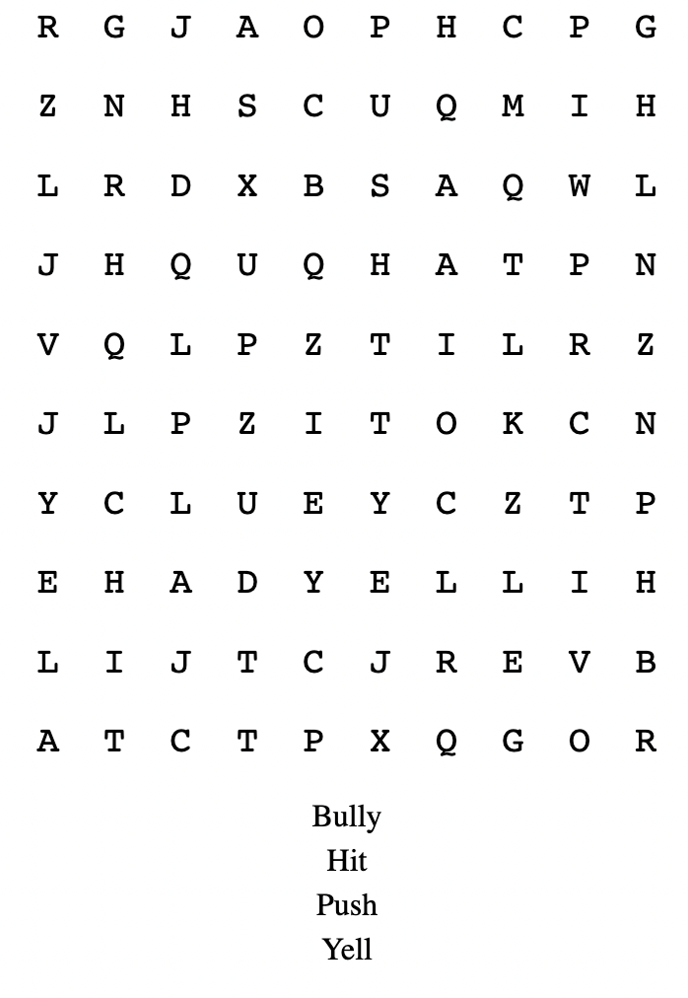


BAD CHOICES

Slide 10
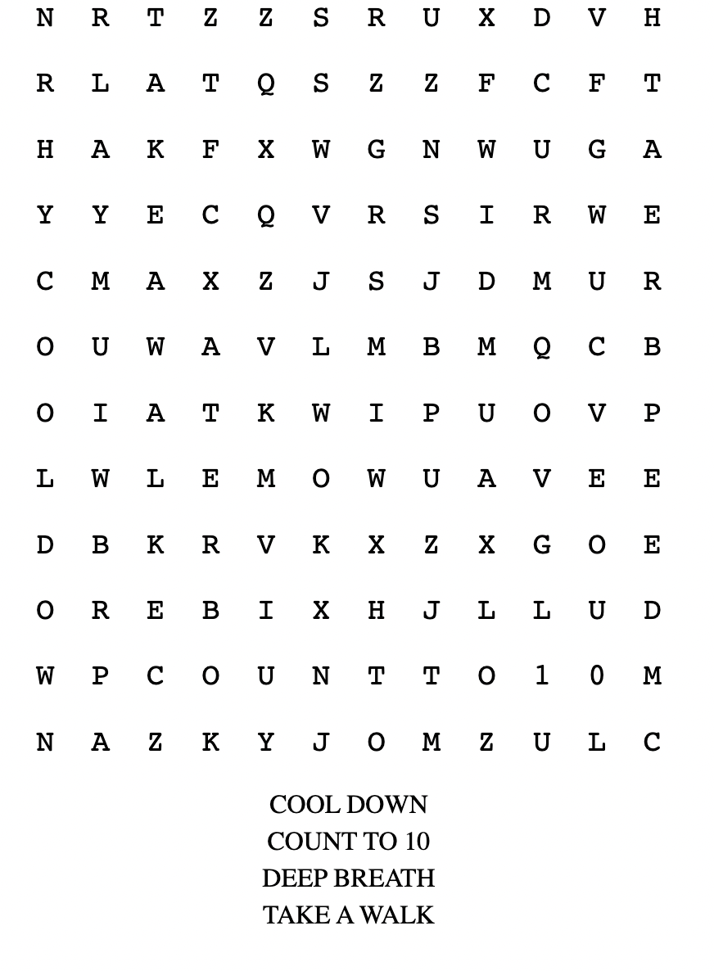


GOOD CHOICES

